Slide 1
SPICES

Slide 2
SPICES
Spices are aromatic products or substances of a plant origin, obtained from dried plant parts such as fruits, seeds, flowers, roots, bark or other plant parts.
They are primarily used for flavoring coloring or preserving of foods and are characterized by strong aroma and sweet or bitter characteristic flavour.

Slide 3
India, known as the land of spices, contributes more than 63% of the world spice production (2,413,284 tonnes).
Kerala is known as the spice bowl of the world,

Slide 4
King & Queen of spices
King of Spices : Black pepper is generally referred as
‘King
great
of Spices’ or ‘Black Gold’ due to its widespread use,
commercial importance as well as its innumerable
medicinal applications.
Queen of Spices : Small or lesser cardamom (Elettaria cardamomum) is commonly referred as the Queen of Spices. Known as chhoti ilaichi, contains more than 25 volatile oils and
other phytochemicals which impart fragrance and flavour to it.

Slide 5
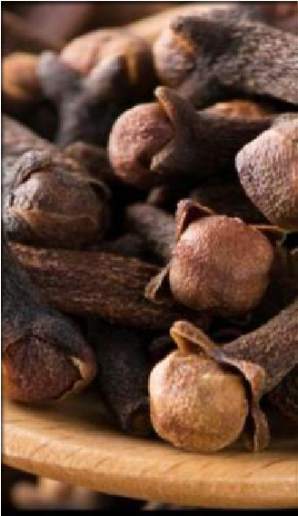
a] CLOVE
BOTANICAL NAME : Syzygium aromaticum
COMMON NAME FAMILY
PART USED
: Laung
: Myrtaceae
: Unopened flower bud
MORPHOLOGY –
HEIGHT :- medium-sized, evergreen tree with a height of 10-20m.
STEM :- much branched and has grey bark.

Slide 6
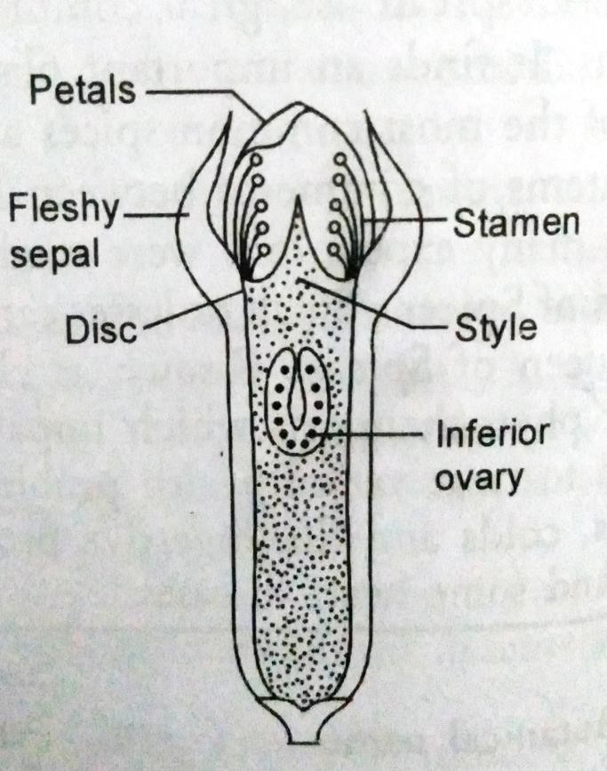
LEAVES – elliptical in shape and arranged oppositely.
  highly aromatic due to presence of glands containing volatile oils.
4.LIFE SPAN – It can live up to 100 years or more.
FLOWERS – Flowers are borne in terminal cymes with three flowers in each group.
  highly fragrant, crimson-coloured and borne on a cylindrical base.
Sectional view of flower bud of clove
6. FRUIT – fruit is 1.5-2.5 cm long purple drupe.

Slide 7
USES :
AS A SPICE – cloves are widely used in curry powders and masalas.
  They find extensive use in biriyanis’ to enhance flavour of the rice in
SouthIndia.
FLAVOURING MEAT — Whole and ground cloves are used to enhance the flavour of meat and rice dishes.
CLOVE OIL – extensively used for flavouring of meats, baked goods, candies and table sauces..
  also used in aromatherapy and to treat toothache
INDUSTRIAL APPLICATION – close oil is extensively used in toothpastes, perfumes, chewing gums, soaps and mouth washes.

Slide 8
MEDICINAL USES – Cloves are highly valued in medicines.
  They’re reported to have anti-inflammatory, painkilling, anti- bacterial, anti-viral and anti-fungal properties.
  The medicinal properties of clove are due to the presence of eugenol.
  Traditional Ayurvedic healers in India have used cloves since
Ancient times to treat respiratory and digestive ailments.

Slide 9
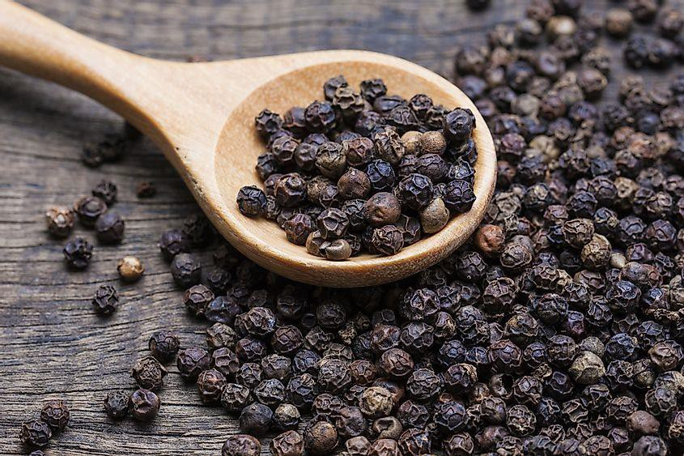
b] BLACK PEPPER
BOTANICAL NAME : Piper nigrum
COMMON NAME FAMILY
PART USED
: Kali mirch
: Piperaceae
: Fruit
MORPHOLOGY :
HEIGHT - It can grow up to a height of 4-6 m on supporting trees (sometimes also on poles).
STEM - branched, has long internades and develops roots on the nodes which helps in climbing.

Slide 10
LEAVES – simple, altermate and often unequal sided.
  Black pepper is a self-pollinating plant.
FRUIT – fruit is a sessile globose drupe (though known as berry) with a pulpy pesicasp.
  Green unripe fruits turn red on ripening and turns black after drying.

Slide 11
USES :
1. UNIVERSAL SPICE :
important spice.
one of the oldest and World’s most
Because of its widespread and wide ranging uses in kitchen, it is also known as “king of spices”.
FLAVOURING INGREDIENT : In non-alcoholic beverages, candies, baked foods, meat products and cheese.
PEPPER OIL : Peper oil obtained from peppercorns is used. •As an adjunct in flavouring of sausages, soups and table sauces.

Slide 12
ANTI-OXIDANT : Various scientific studies have proved that black pepper has strong anti-Exidative properties and delays aging.
MEDICINAL USES : Black pepper has high medicinal value and therefore, widely und to stay healthy and also to treat various disease conditions.
  The pepper fruits have carminative, anti- inflammatory, analgesic and stimulant properties.
  It stimulates the digestive juices and enzymes and promotes digestion.
  Black pepper delays the brain aging.

Slide 13

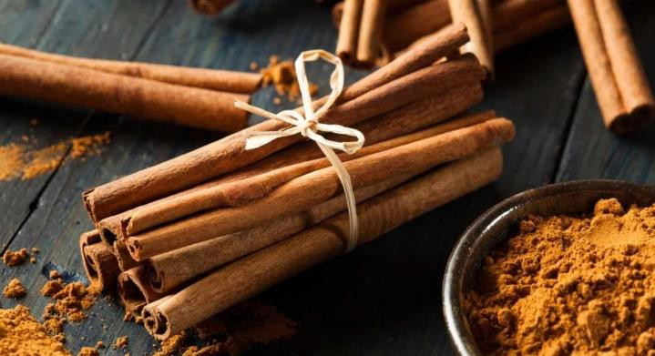


c] CINNAMON
BOTANICAL NAME : Cinnamomum verum
COMMON NAME FAMILY
PART USED
: Dalchini
: Lauraceae
: Dried inner back of the tree.
MORPHOLOGY –
HEIGHT – small evergreen tree growing to a height of 10-15m
STEM – highly branched and covered with thick grey bark.
  The bark tissue is characterized by the presence of secretion cells containing mucilage or oil.

Slide 14
3. LEAVES – The leaves are variable in size, opposite and 7-18 cm long.
FLOWER – actinomorphic, bisexual and trimerous.
FRUIT – fruit is a fleshy, one-sided, ovoid black or purplish black- coloured berry.
  USES :
UNIVERSAL SPICE – The inner back of cinnamon ce is used. As a condiment for flavouring foods. Meat, sweats, and other food stuffs.
CINNAMON OIL – Volatil oils obtained from cinnamon bark and leaves are used in perfumes, chewing gums, chocolates in Mexico and other food items.
  It is also used for flassuring pharmaceuticals and soap.

Slide 15
MEDICINAL USES – It is used as an ingredient in many Ayurvedic and Unani medicinal preparations..
  It has been proved to be useful in cough, cold, diabetes in regulating cholesterol.
Cinnamon possess various biological actriusties such as carmi –native, anti- oxidant, anti-microbial, anti-diabetic anti-inflammatory and anti-allergic.
INSECTICIDAL ACTIVITY– Cinnamon possesses insecticidal properties.
NEMATICIDAL ACTIVITY – Cinnamon oil also possesses nematicidal activity against some nematodes.

Slide 16
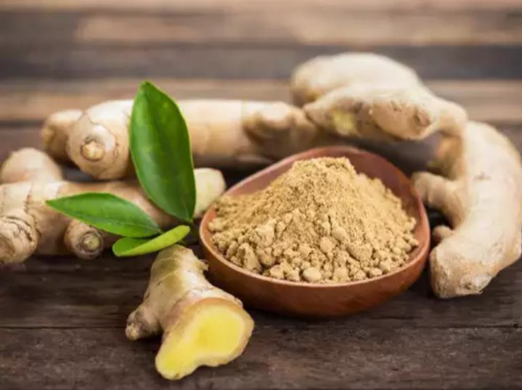
d] GINGER
BOTANICAL NAME : Zingiber officinale
COMMON NAME FAMILY
PART USED
: Adrak
: Zingiberaceae
: Rhizome
MORPHOLOGY :
Ginger (Zingiber officinsale) is a perennial herbaceous plant
ROOTS : Manny fibrous adventitious roots arise from the rhizomes (underground stem).
STEMS : Pseudostems ( false stem made up of rolled bases of leaves), arising from the underground rhizomatous stem, are elect, slender, rounded,

Slide 17
and annual.
LEAVES : distichous (arranged alternately in two rows).
  Each leaf is divided into basal sheath and terminal lamina.
INFLORESCENCE : The inflorescences arise directly from the rhizome and bear flowers.
FLOWERS : pale yellow and streaked with purple.
FRUIT : Fruit, which develops only rarely, is a triangular ovale capsule containing numerous blackish seeds.
  USES –
1. AS A SPICE – The fresh rhizomes of ginger are used as a spice for flavouring racious foods thoroughout the world.

Slide 18
FLAVOURING OF BEVERAGES : Ginger is traditionally used for flavouring of different non- alcoholic (herbal Tea, adrak chai, soupi, etc ) and alcoholic (ginger wine, ginger beer) bererages.
PICKLES : Ginger can be pickled in vinegar or sherry.
MEDICINAL USES : It is used as an ingredient in many Ayurvedia, Unani and traditional medicinal preparations.
Ginger has been used traditionally to aid in digestion, to treat upset stomach, diarrhoea, and nausea.
  It is reported to have anti-oxidant, anti-carcinogenic, anti- inflammatory and anti-tumor activities
Ginger tea is given to persons suffering with cough and cold. Ginger increasse rate of perspiration and give a feeling of
warmth.

Slide 19
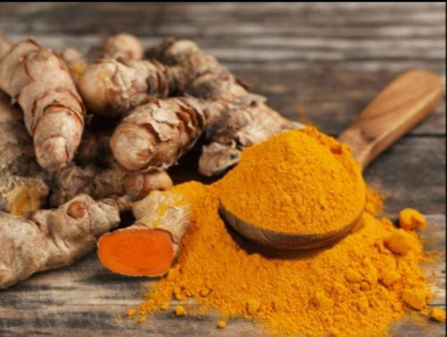
e) TURMERIC
BOTANICAL NAME : Curcuma longa
COMMON NAME FAMILY
PART USED
: Haldi
: Zingiberaceae
: Rhizome
MORPHOLOGY –
Turmeric is a herbaceous plant, surviving through perennial rhizomes.
ROOTS : - Many fitmous adventitious roots arise from the rhizomes (underground stem).
  Rhizome is highly branched, yellow to orange in colour, cylindrical and
aromatic.

Slide 20
LEAVES : The leaves are distichous (arranged alternately in two rows) and long petioled.
•They are divided into leaf sheath, petiole and lamina or leaf blade.
  The leaf sheaths form false stem.
INFLORESCENCE : The inflorescence, a spike, arises directly from the rhizome during rainy season.
FLOWERS : The flowers are pale yellow, covered by pinkish bracts, bisexual and zygomorphic.
FRUIT : Turmeric does not bear fruits, as it is a sterile triploid.
  However, if it bears fruit rarely, it is a capsule.

Slide 21
USES :
AS A SPICE : Indian have been using turmeric as a spice for thousands of years.
  It is used as an additive to improve the palatability of foods.
MEDICINAL USES : • It is extensively used in Ayurvedic, Unani,
Chinese and traditional medicinal preparations.
  Turmeric is reported to be stomachic, tonic, blood purifier, anti- inflammatory and liver protectant.
  Recent epidemiological observations have suggested that turmeric
consumption may reduce certain forms of cancers.

Slide 22
FOOD COLOURANT : Turmeric can be used as a a food colourant (for butter, cheese, etc.) in place of synthetic dye tartrazine.
  It is one of the principal ingredients in curry powrder.
PICKLES : Tumeric powder is added to pickles as flavouring and colouring agent.
DYE : Tumeric powder was used for dying cotton, silk and wool in old
times.
SACRED USES : Turmeric is considered sacred by Hindus.
・It is offered to deities during religion ceremonies.
  Turmenc vermilion is put on the forehead in some temples and during
sacred occasions.
-Turmeric is used as one of the nine plants of navapatrika during Durga festival.

